Slide 1
Kalman Filter
Presentation by Ethan Davidson

Slide 2
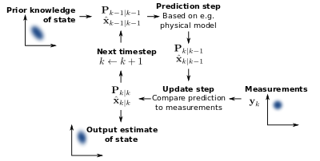
Overview
A Kalman filter is an optimal estimation algorithm
It can be used to estimate a system state that cannot be measured directly
Named after Rudolf E. Kalman (1930-2016)
Common applications: guidance and navigation systems, computer vision systems, signal processing
The first applied use of this filter was to estimate trajectories of the Apollo shuttle

Slide 3
State Observers
State observation allows for estimation of data that cannot be directly measured
Hat variables such as Xhat and Yhat are estimated states through the state observer
We are able to create a mathematical model that can accept inputs of our real data and output hat variable approximations of the outputs
These hat variable outputs cannot be fully accurate, but will improve as the mathematical model improves
To minimize the difference between estimated and measured outputs, we can use a feedback control system using control variable K

Slide 4
Optimal State Estimator
To minimize the difference between the actual value of the variable we are attempting to predict (Y_{k}) and corresponding state observer (Yhat), the Kalman filter uses an optimal state estimator
The measurement data points often contain measurement noise, which we represent as V_{k}, which is assumed to be drawn from a Gaussian distribution with zero mean and covariance matrix R
The process data also contains noise which we represent as W_{k}, drawn from a Gaussian distribution with zero mean and covariance matrix Q

Slide 5
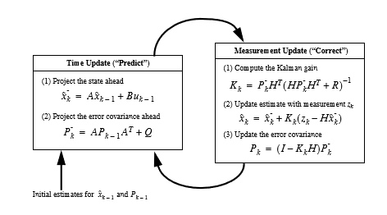
Optimal State Estimator (cont.)
For each time step k, the uncertainty in the Xhat estimate increases
To find the optimal estimate, we can multiply the probability functions for estimate Xhat and noisy measurement Y at step k, which produces a Gaussian function with a smaller variance than either of the two estimates alone.

Slide 6
Extended Kalman Filter
A standard Kalman filter is used to estimate the state of a discrete-time controlled process governed by a linear stochastic difference equation
For our purposes of smoothing nonlinear data, we need a filter that linearizes about the current mean and covariance for each given time step

Slide 7
Smoothing Filters
Even with an extended Kalman filter, if our goal is to smooth a set of noisy data, simply relying on the current and past time steps is not optimal
Instead, we can incorporate future measurements into the estimate for step k, so k+1 through k+n will be evaluated along with k-1 through k-n
This creates a more optimal smoothing effect when compared to a low pass filter

Slide 8
Fixed-Lag Smoothing
FilterPy is a Python library that implements many Bayesian filters including Kalman and Extended Kalman filters
For our data testing purposes, I found the Fixed-Lag Smoothing the most useful implementation as it does not need to be ran in batch mode and can read directly from the dataframe

Slide 9
Sources
https://github.com/rlabbe/Kalman-and-Bayesian-Filters-in-Python/blob/master/13-Smoothing.ipynb
https://www.cs.unc.edu/~welch/media/pdf/kalman_intro.pdf
https://www.mathworks.com/videos/series/understanding-kalman-filters.html

